Slide 1



2 – About R & RStudio
they’re the same, right? Right?!

Slide 2
R vs RStudio
What is the difference between R and RStudio?
RStudio requires R to run in the background
R is the engine, RStudio is the rest of the car
Software Center might call R the “R Project”; avoid calling it that.
We’ll be using RStudio Projects (sometimes called R Projects) which is a very different concept
Notes:
R is the language (and a very minimal program); RStudio is a full featured program. Think of Notepad vs MS Word.
RStudio is a popular program that runs on top of R
There are other “IDEs” to use but this is the best suited to R
It is HIGHLY recommended to just use this
I will not show or use the base program R today
Downsides: None until you’re a world-class expert
NOTE: If you don’t open RStudio thru clicking the .RProj file, you will have issues.

Slide 3


To Open R
Going forward, when we say “Open R”, this will mean RStudio
Open this
Not this
R 4.4.3
RStudio
From now on, open RStudio
Easiest to double click the .Rproj file
Even if you have RStudio open already, double click the .Rproj file anyways :)

Slide 4
RStudio
You’ll see 4 panes. By default, they are:
Script editor in top left where you can write code before evaluating it,
Console in bottom left where code is evaluated and output is seen,
Environment in top right shows variables/dataframes (click on them to open and view!),
Plot/Help area in bottom right.
gif: https://www.pipinghotdata.com/posts/2020-09-07-introducing-the-rstudio-ide-and-r-markdown/

Slide 5
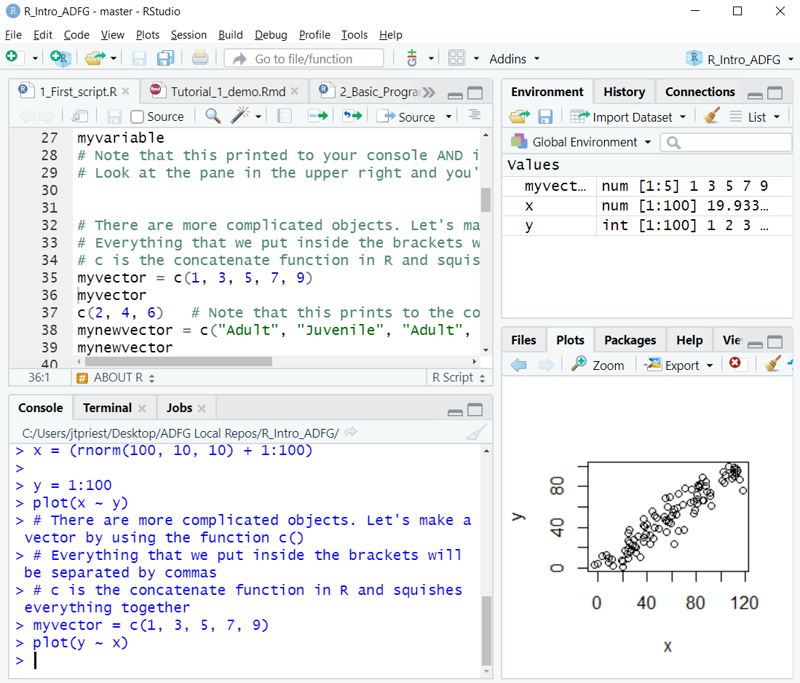
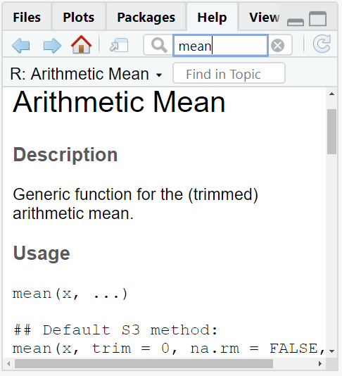
Script – A collection of lines of code saved to a file that can be run line by line, or all at once, usually the file extension is .R
If you want to save the code to use it again, you must save it in a script file
Script Editor
Environment
Environment – Shows all your variables. If it’s a dataframe, it’s clickable
Project – Shows which project you’re in. More on this later
Line – In script section each command has its own line. Lines must be complete bits of code otherwise they won’t evaluate (to wrap an incomplete chunk of code to the next line, it must end in a comma or something similar)
Plots / Help
Console
Plots – Shows your recent plots.
Help – Access the help file for every function
Console – The bottom part of the program where you can enter code to be run and where executed code is shown
5
Notes:
Perhaps the most useful feature of RStudio. Rprojects makes .rproj file; double click on this to re-open all the same scripts as last time AND set the directory to be the current folder

Slide 6
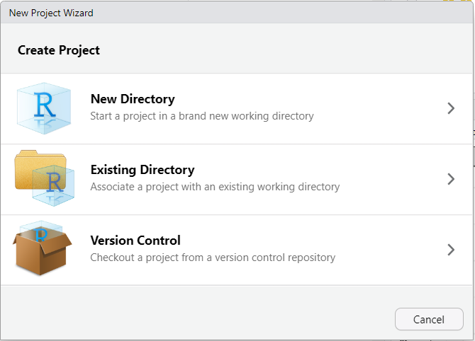
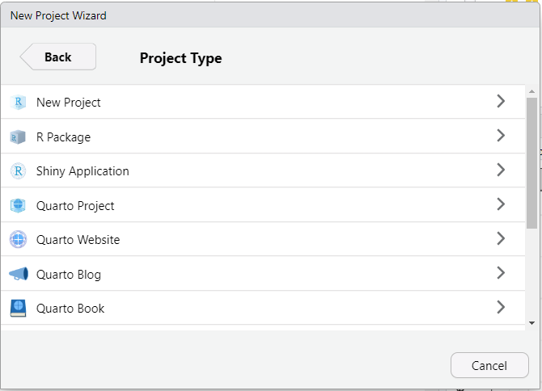
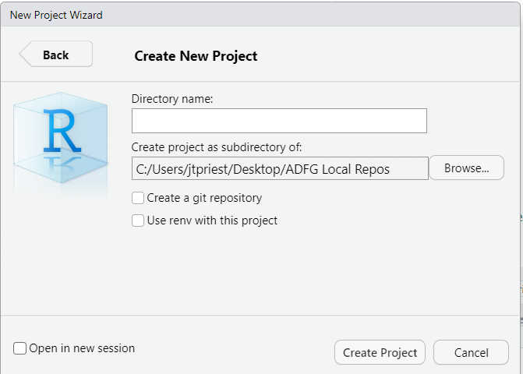

RStudio Projects
We highly recommend using RStudio projects
To create a new project:
Open RStudio. Click File -> New Project
New Directory (creates new folder you’ll move files to) or Existing Directory
Click New Project
Give descriptive name, choose where folder will be (can open in new window)
gmu13_blackbear_harvest

Slide 7
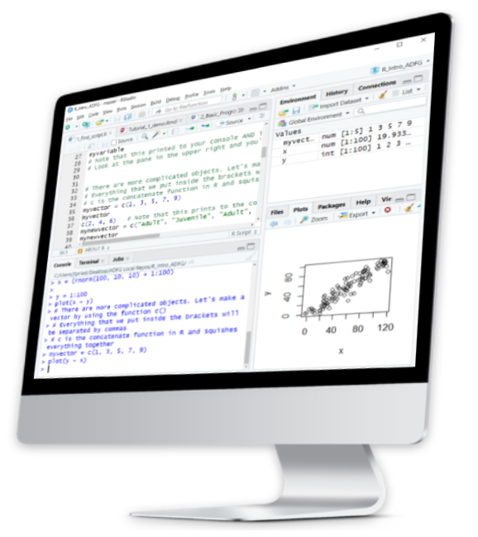
RStudio Demo
Let’s demo this in RStudio!
We’ll go over:
Unzipping folder we sent
How to start / open RStudio
What each “pane” is
Where to type your code
How to make a new RProject

Slide 8
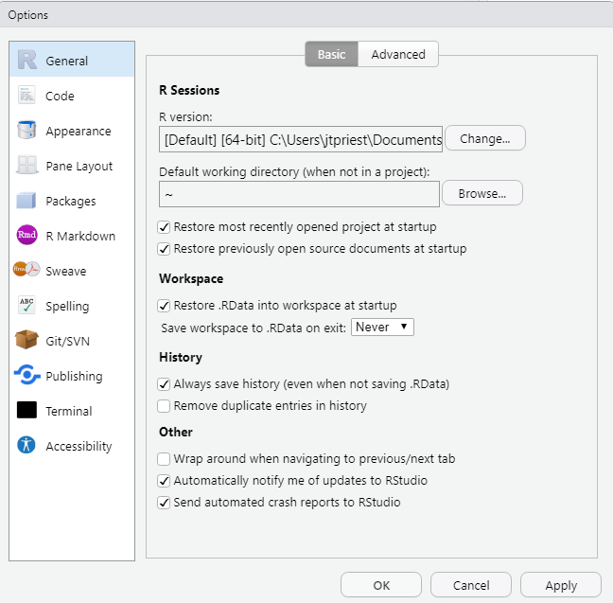
RStudio cont.
Highly recommended to change one default setting. Go to:
Settings
Click Tools -> General Options
This will bring up these options
Change “Save workspace to .RData on exit” to Never

Slide 9
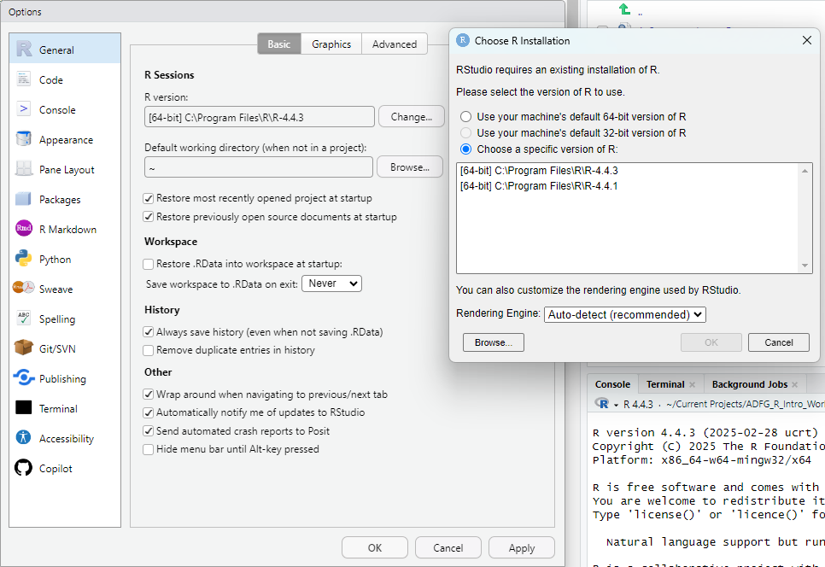
Possibly worth checking (particularly if you installed R once upon a time):
Did RStudio find the most recent version of R?
It may say “R Project” with no version number – this is probably not the most recent

Slide 10
RStudio cont.
Back to RStudio!
Let’s make those changes
We’ll also go over:
Advantages of RStudio projects
How to open a script
Highlighting a word
Changing the theme
Using the help tab

Slide 11



So wait, what does an RStudio Project do?
“Makes it straightforward to divide your work in contexts”
Each work project can (and probably should) have an RStudio Project
Remembers which files are left open (including unsaved ones, somehow)
Automatically sets working directory for data import & export
This is a bigger deal than it sounds like! Much easier to
Share a project with a colleague
Move a project to another (computer) location

Slide 12
Versions
There are different “versions” of R, update the software
Occasionally (~once a year) you may need to update R (or RStudio)
Do this by downloading from Software Center and/or running:
install.packages("installr") library(installr) updateR()
Do you need to worry about R versions?
Do you perform biometrician-level analyses?
No
Yes
Don’t worry, be happy
Pay attention to versions
Notes:
Years ago, there were problems with versions being incompatible. These are largely addressed.
R Versions seem confusing but really are just the latest update of the software.
Some of you may have noticed warnings about versions during package installation
The exception is if you have “biometrician-level” software that integrates with R (e.g., JAGS or ADMB)

Slide 13
Quiz 2-1
When should you open the program “R” instead of RStudio?
a) Never. We always use RStudio.
b) Always. Kick it old school R
c) Always. I am a crusty old biometrician.
What are some advantages of using R projects?
a) Future advantages we haven’t covered yet.
b) Opens most recent scripts
c) Sets folder directory automatically
QUIZ!

Slide 14

Quiz 2-1 ANSWERS
When should you open the program “R” instead of RStudio?
a) Never. We always use RStudio.
b) Always. Kick it old school R
c) Always. I am a crusty old biometrician.
What are some advantages of using R projects?
a) Future advantages we haven’t covered yet.
b) Opens most recent scripts
c) Sets folder directory automatically
QUIZ!

Slide 15
Jargon
Function A set of commands that evaluates your data in a specific way. You can write your own functions, or they can be provided via other packages or from “Base R“.
Argument In a function, this is a possible input. For example: mean(data, na.rm = TRUE) uses an argument to remove NAs
Package A group of new commands / functions to extend the functionality of Base R.
Variable Something saved in R’s memory for use later.
Notes:
We’re going to throw some necessary jargon at you, and THESE TERMS WILL BE DEFINED LATER when we’re using them. But this way, hopefully you’re primed!

Slide 16
Jargon cont.
Dataframe A group of rows and columns (like a spreadsheet). Each column has a specific type (TRUE/FALSE, integer, number, character, factor, etc.).
Factor A type of variable that is a categorical grouping (“red” vs “blue”; “Treatment1” vs “Treatment2” vs “Treatment3”).
<- The “leftward arrow” assigns the information on the right to the variable on the left. For example: x1 <- 42
c() Lowercase c means concatenate which groups a bunch of things together. For example: x1 <- c(“duck”, “duck”, “duck”, “goose!”)
Notes:
We can use the rightward arrow too but this is less common

Slide 17
Some special characters
[ ] Square brackets mean selecting a subset
== To check if things are equal, use two equals signs together
!= To check if things are NOT equal, use this
<, <=, >, >= Less than (or equal to), greater than (or equal to)
&, |, !, %in% And, or, not, is contained in
~ In base R the tilde usually means “as a function of…”
(in the context of plotting or regression)

Slide 18
More special characters
$ Selects a particular column of a dataframe, or something else with a name For example: dataframename$column1
# Makes a “comment” (not run code), telling R to not run anything on this line to the right
> print(“Hello!”) #This line only evaluates the Hello! part ignoring this
Also: Lines must end with a comma, bracket, or similar. If you want your code to continue to the next line, you will need a comma at the end of a line
Notes:
Removed these two:
rm() Removes a variable from your workspace
str() Inspects the structure of a variable

Slide 19
Let’s head to RStudio
Let’s familiarize ourselves with RStudio
You are learning two things at once: the new-to-you program RStudio and the R language
We’ll put what we just learned to use in RStudio and review the basics of the program. You can watch my screen and write the code yourselves too.
Later, revisit the script on your own. Consider modifying lines
Read the comments then run the line (“Run” or Ctrl+Enter)
Go slow, it isn’t a race
Ask yourself why something works or fails

Slide 20
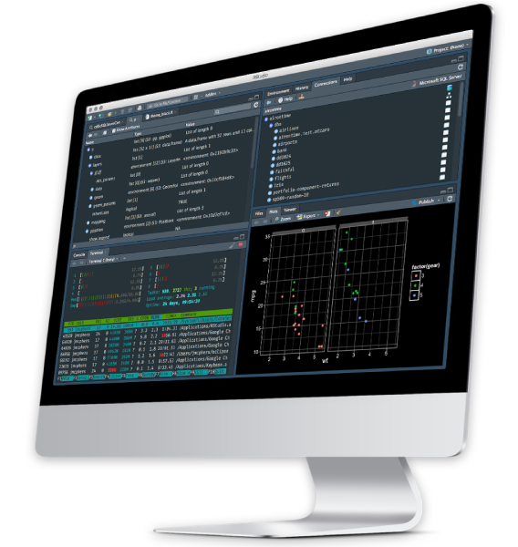
One last RStudio tip
If you’d like, you can change the appearance of RStudio (color & theme)
Go to Tools -> Global Options -> Appearance
Choose an “Editor Theme” that you like

Slide 21
RStudio Summary
What we have learned
How to open a RStudio project
4 panes in RStudio
How to run a line
Difference between script & console
Autocomplete for functions & variables
Highlighting a word
Help!
Viewing a dataframe

Slide 22
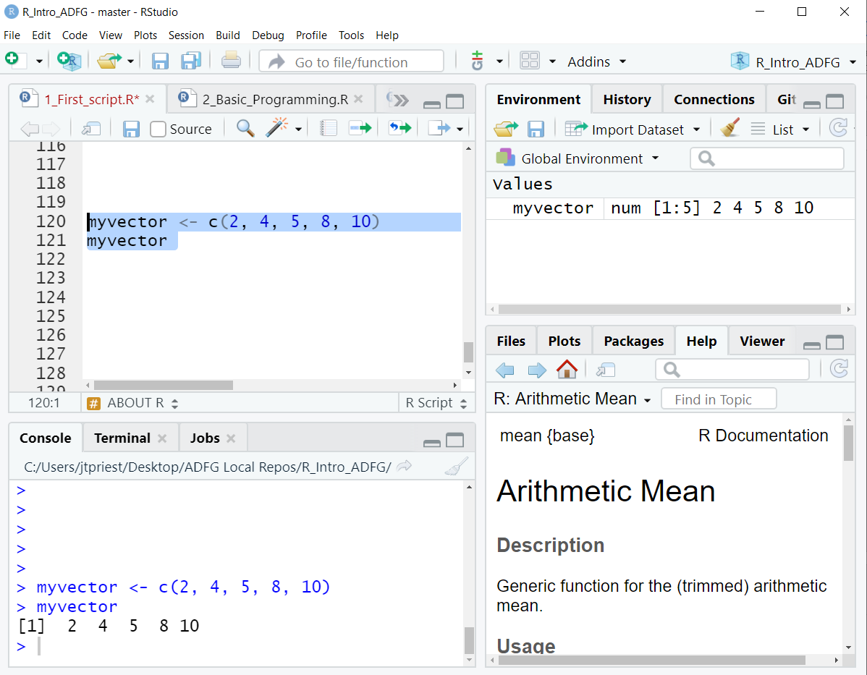
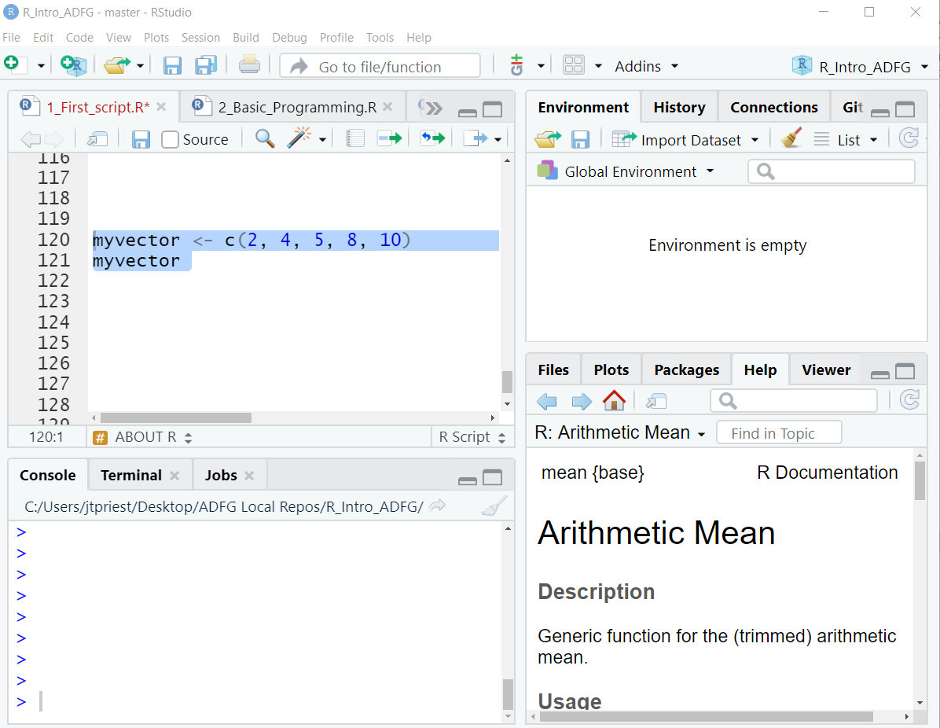
RStudio Review
Use “<-” to store something
Otherwise code doesn’t save for access later (which is often fine!)
Ctrl + Enter (or Run Button) evaluates the line of code (sending it to console)
Put cursor somewhere in that line, or highlight the chunk you want
Objects in the environment disappear once we close R. We’ll need to re-run whole script to get them back. They don’t “live” anywhere permanently.

Slide 23
Quiz 2-2
Which symbols would we use to “set something equal to” and “make a comment / don’t run line”?
a) == and comment()
b) <- and #
c) equal and c()
d) $$ and RUN
How can we tell R to run (evaluate) a line of code?
a) Ask nicely
b) Ctrl + Enter
c) Swear
d) “Run” button
QUIZ!

Slide 24
Quiz 2-2 ANSWERS
Which symbols would we use to “set something equal to” and “make a comment / don’t run line”?
a) == and comment()
b) <- and #
c) equal and c()
d) $$ and RUN
How can we tell R to run (evaluate) a line of code?
a) Ask nicely
b) Ctrl + Enter
c) Swear
d) “Run” button
QUIZ!
Why?
Leftward arrow sets something while the hashtag means don’t run this line
Why?
There are two ways to run a line;
I usually use the keyboard shortcut

Slide 25
Quiz 2-3
How do we “store” a variable to access it later?
a) <-
Chant “variahble returno”
save()
store()
Which pane is the editor (1), and which is the console (2)?
QUIZ!
a)
b)
c)
d)

Slide 26
Quiz 2-3 ANSWERS
How do we “store” a variable to access it later?
a) <-
Chant “variahble returno”
save()
store()
Which pane is the editor (1), and which is the console (2)?
QUIZ!
(1a)editor
(2c)console

